Slide 1
Data Science in R - Introduction
Fall 2021
Yama Chang

Slide 2
Data science is the problem-solving process to quantitatively formulate and rigorously answer questions that emphasizes
clarity, reproducibility, and collaboration,
and communicates the answer to a relevant audience.

Slide 3
What is Data Science?
Data Visualization
Intro to R
Data Analysis
Data Manipulation &
Tidy Data

Slide 4
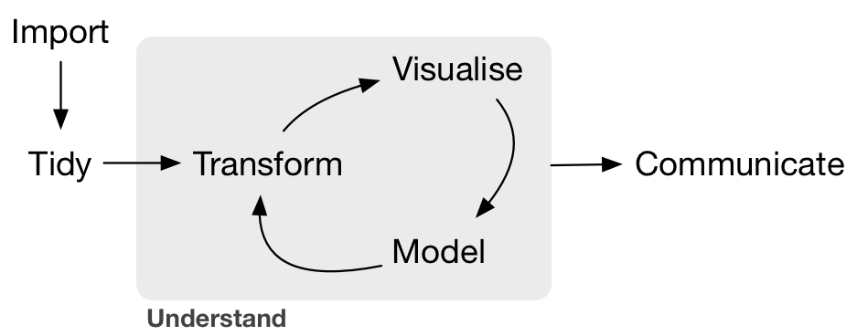
A typical data project
https://r4ds.had.co.nz/introduction.html

Slide 5
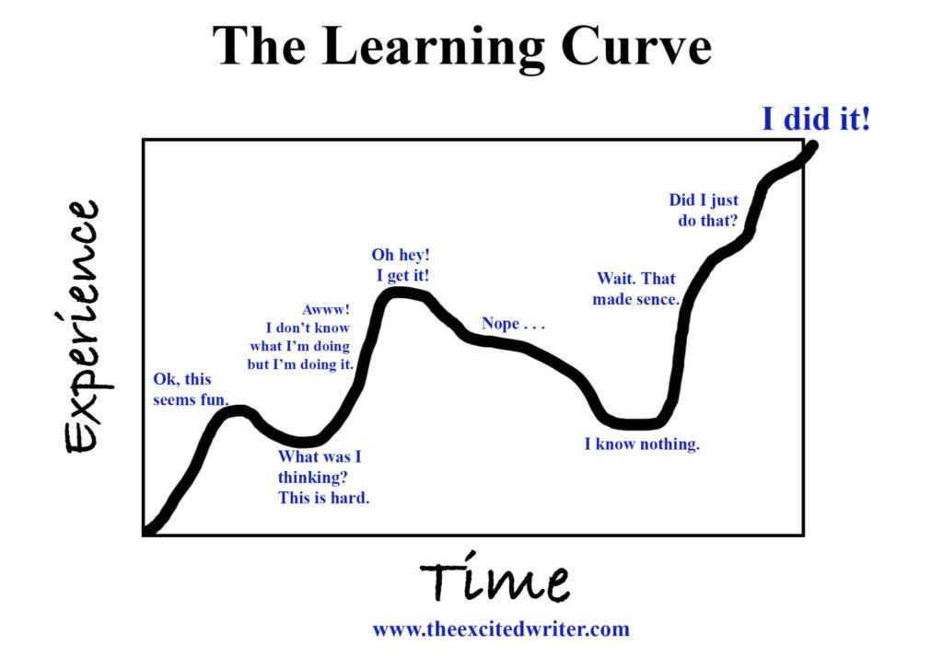

Slide 6
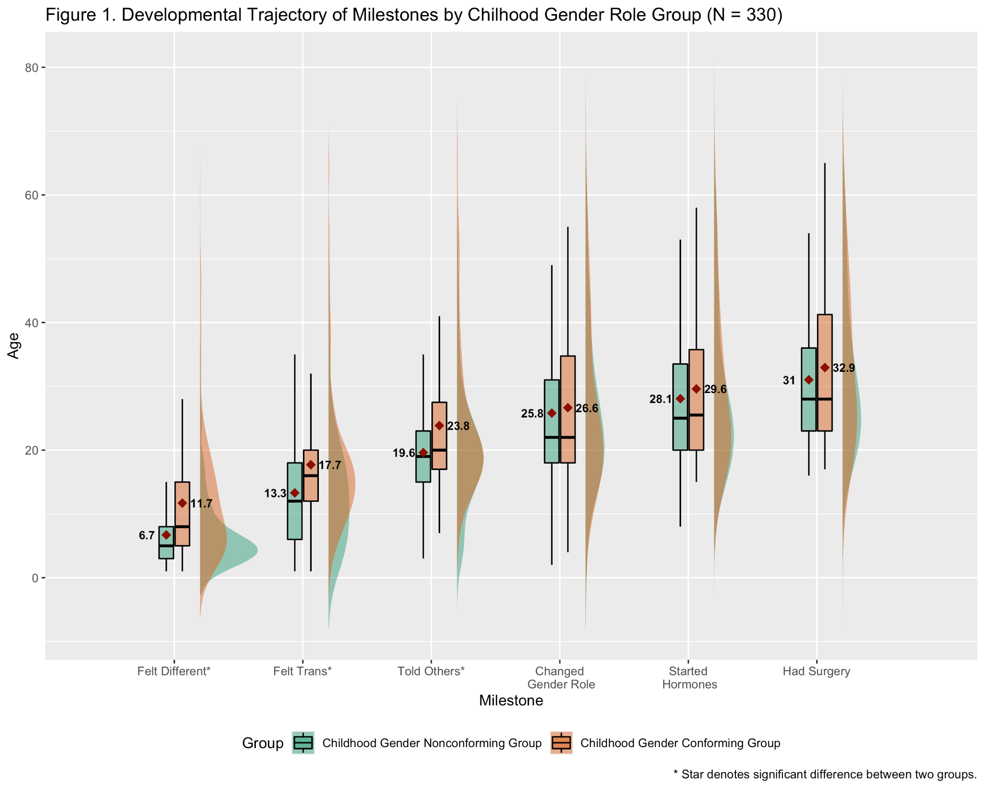

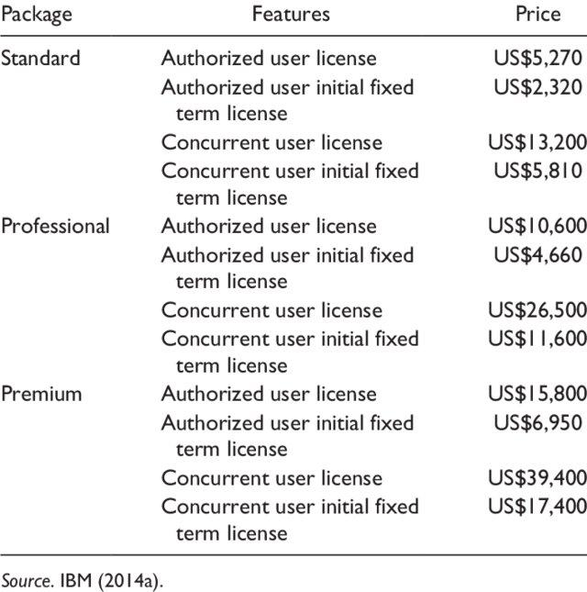
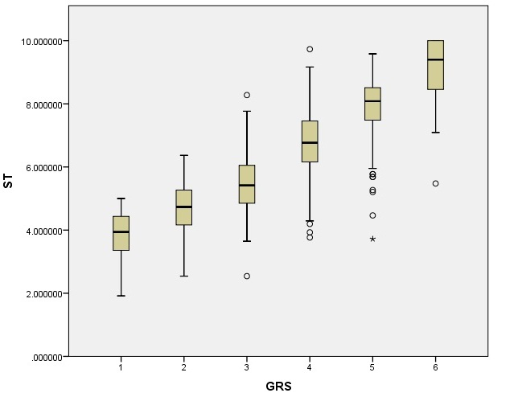
Why learn/use R?
SPSS visualization

Slide 7
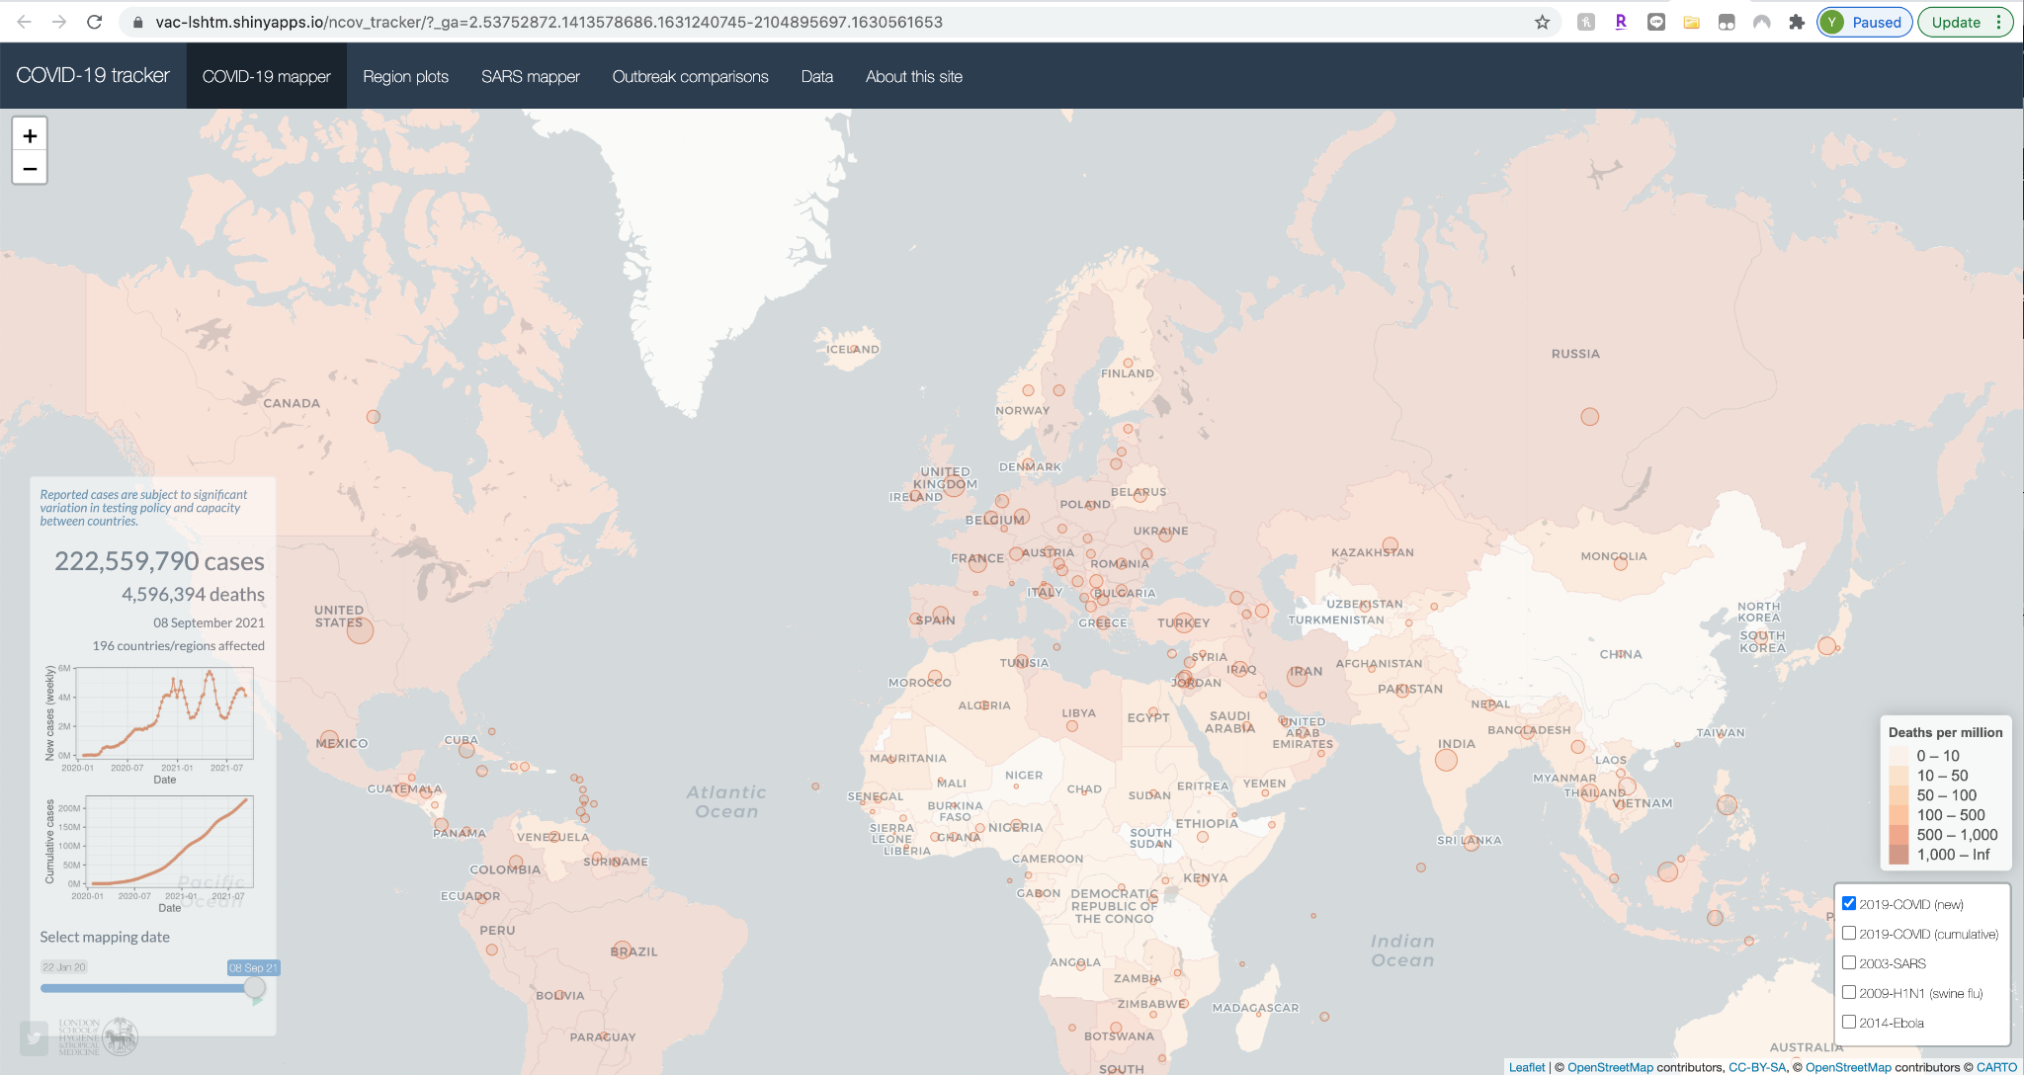
R Shiny apps

Slide 8
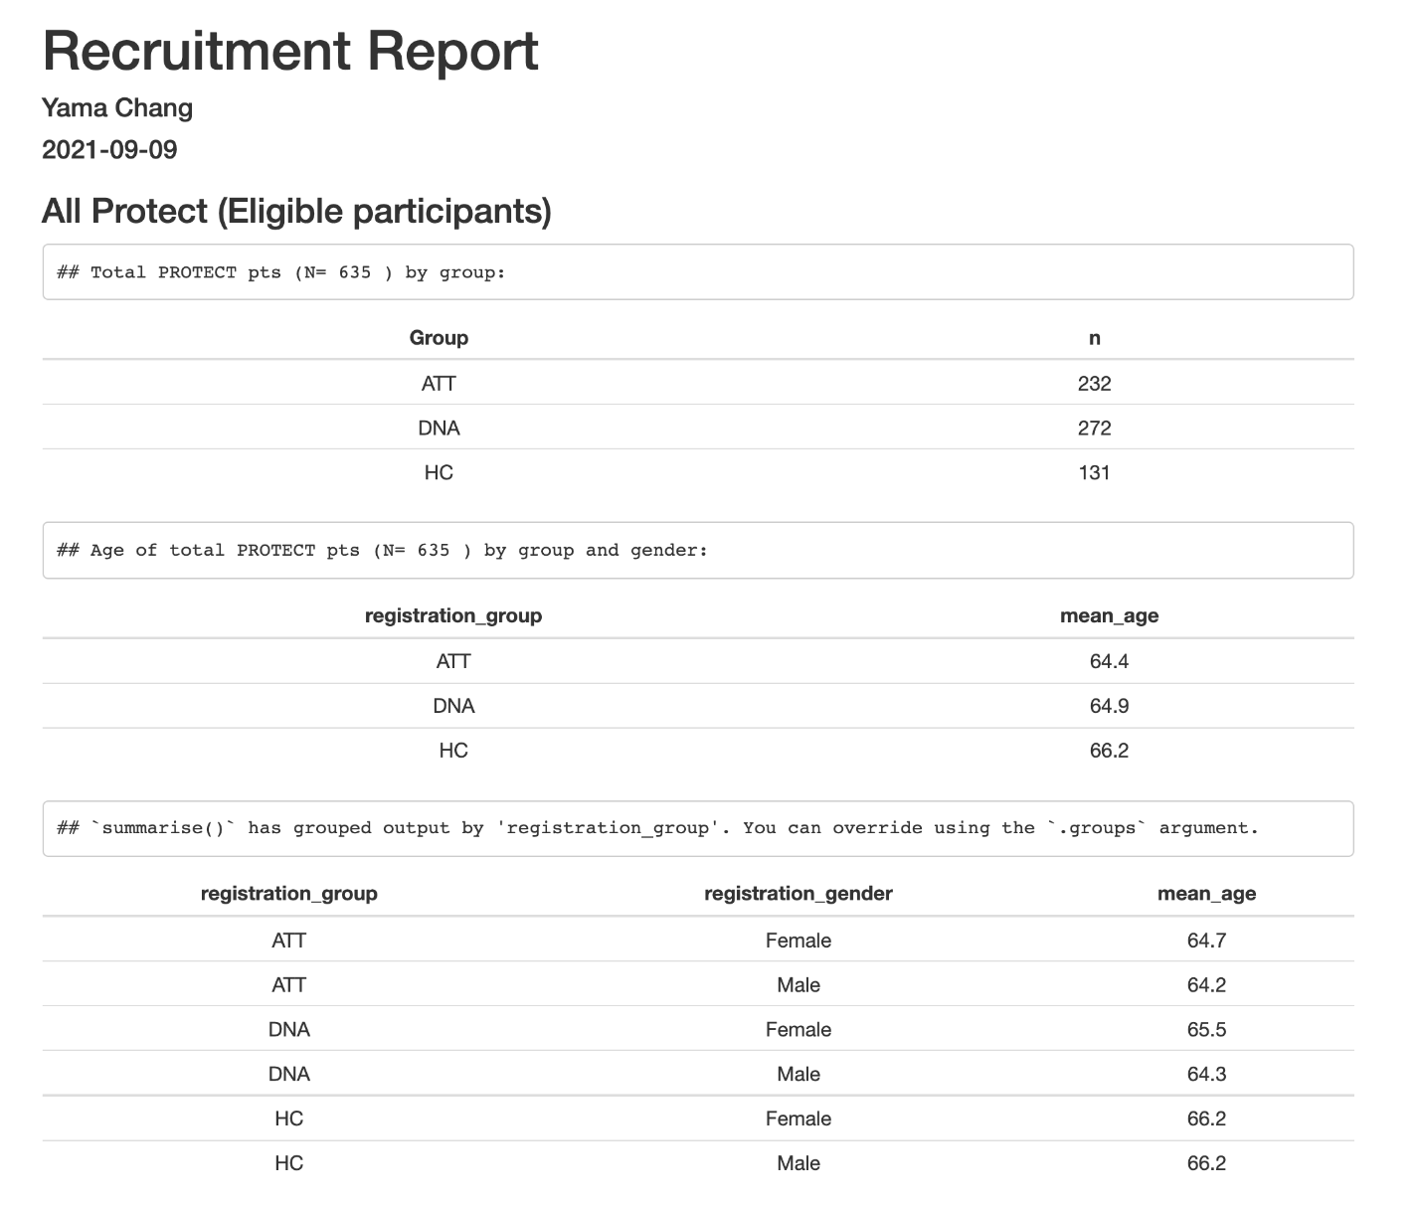
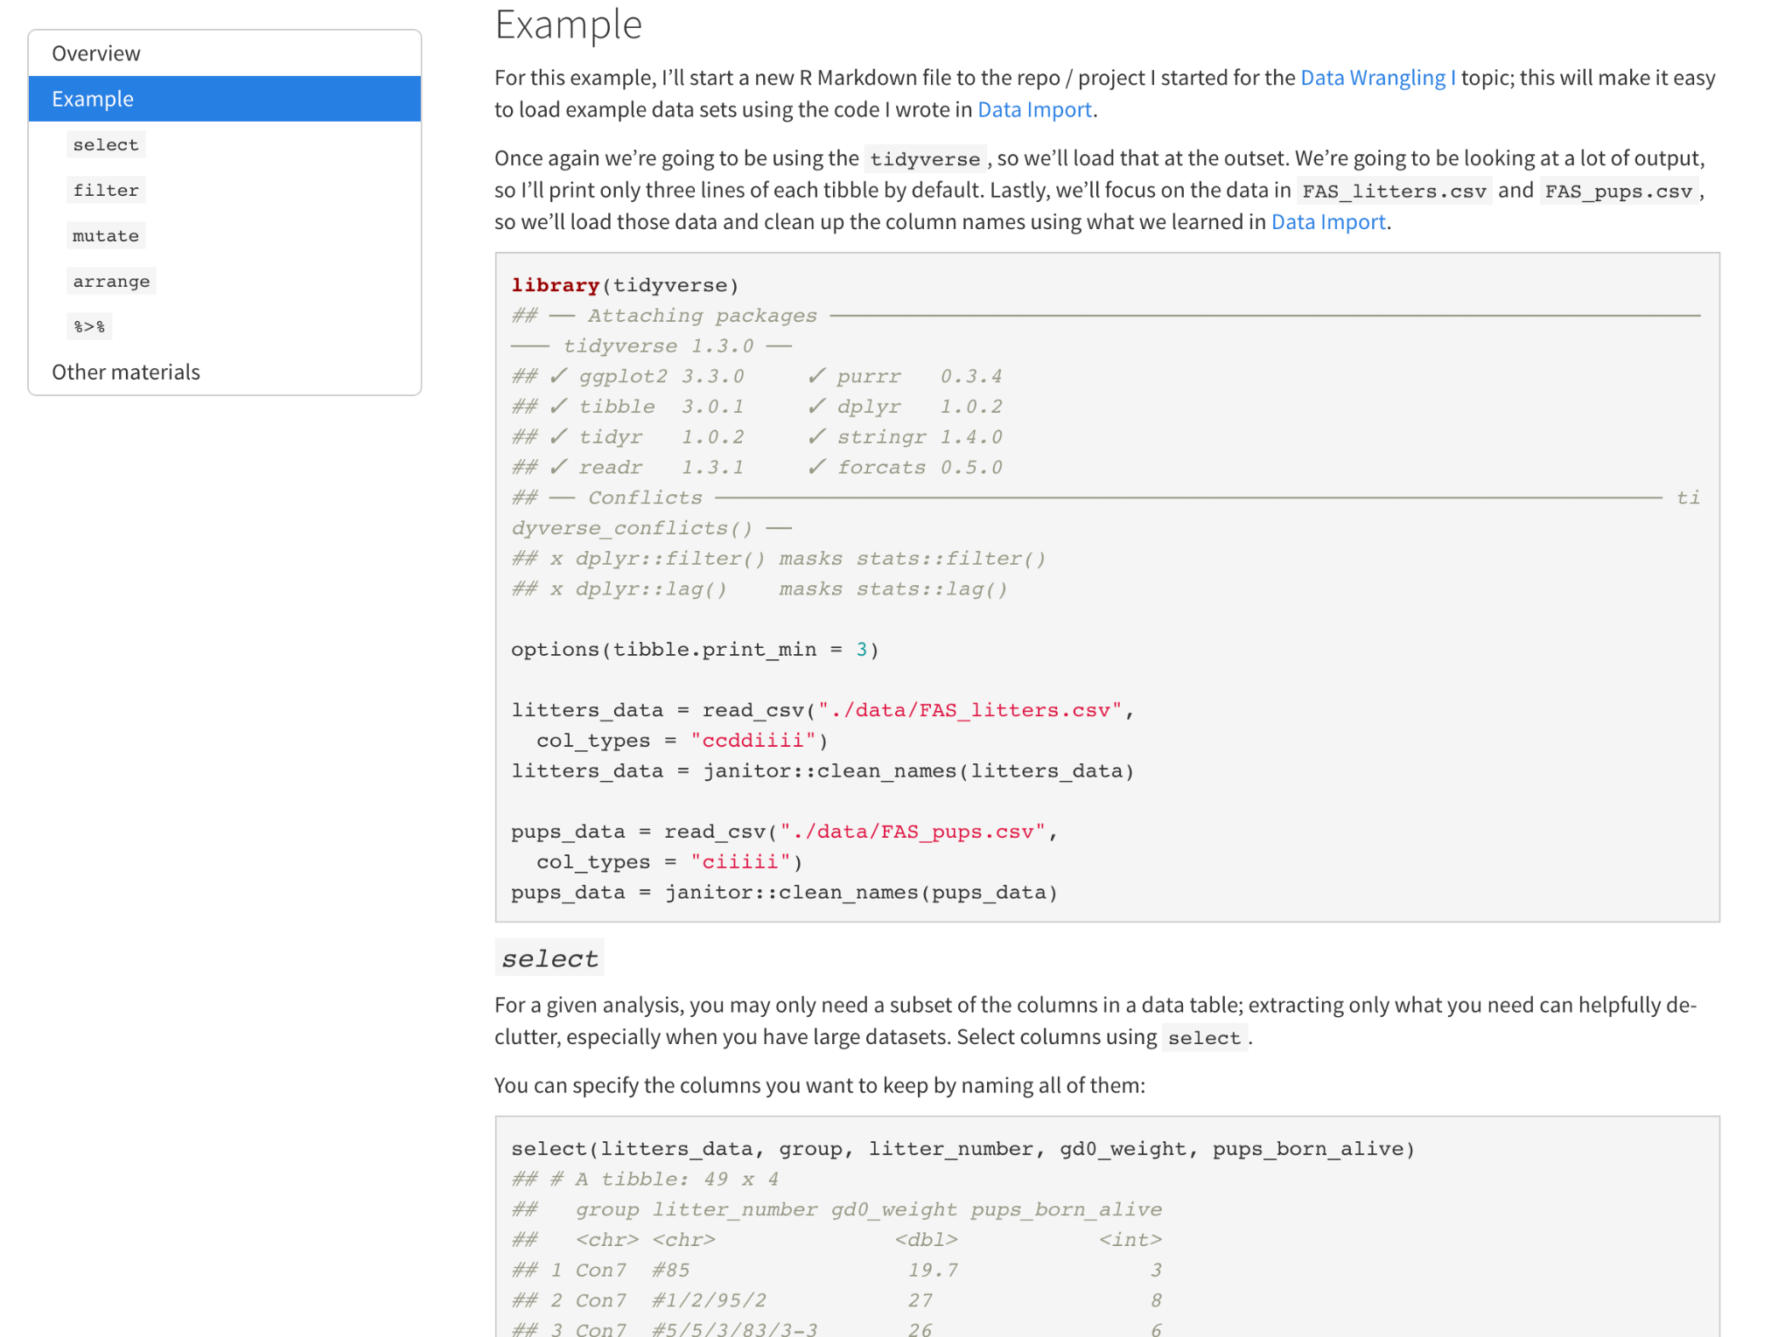
R Markdown
https://www.p8105.com/data_manipulation.html#Example

Slide 9
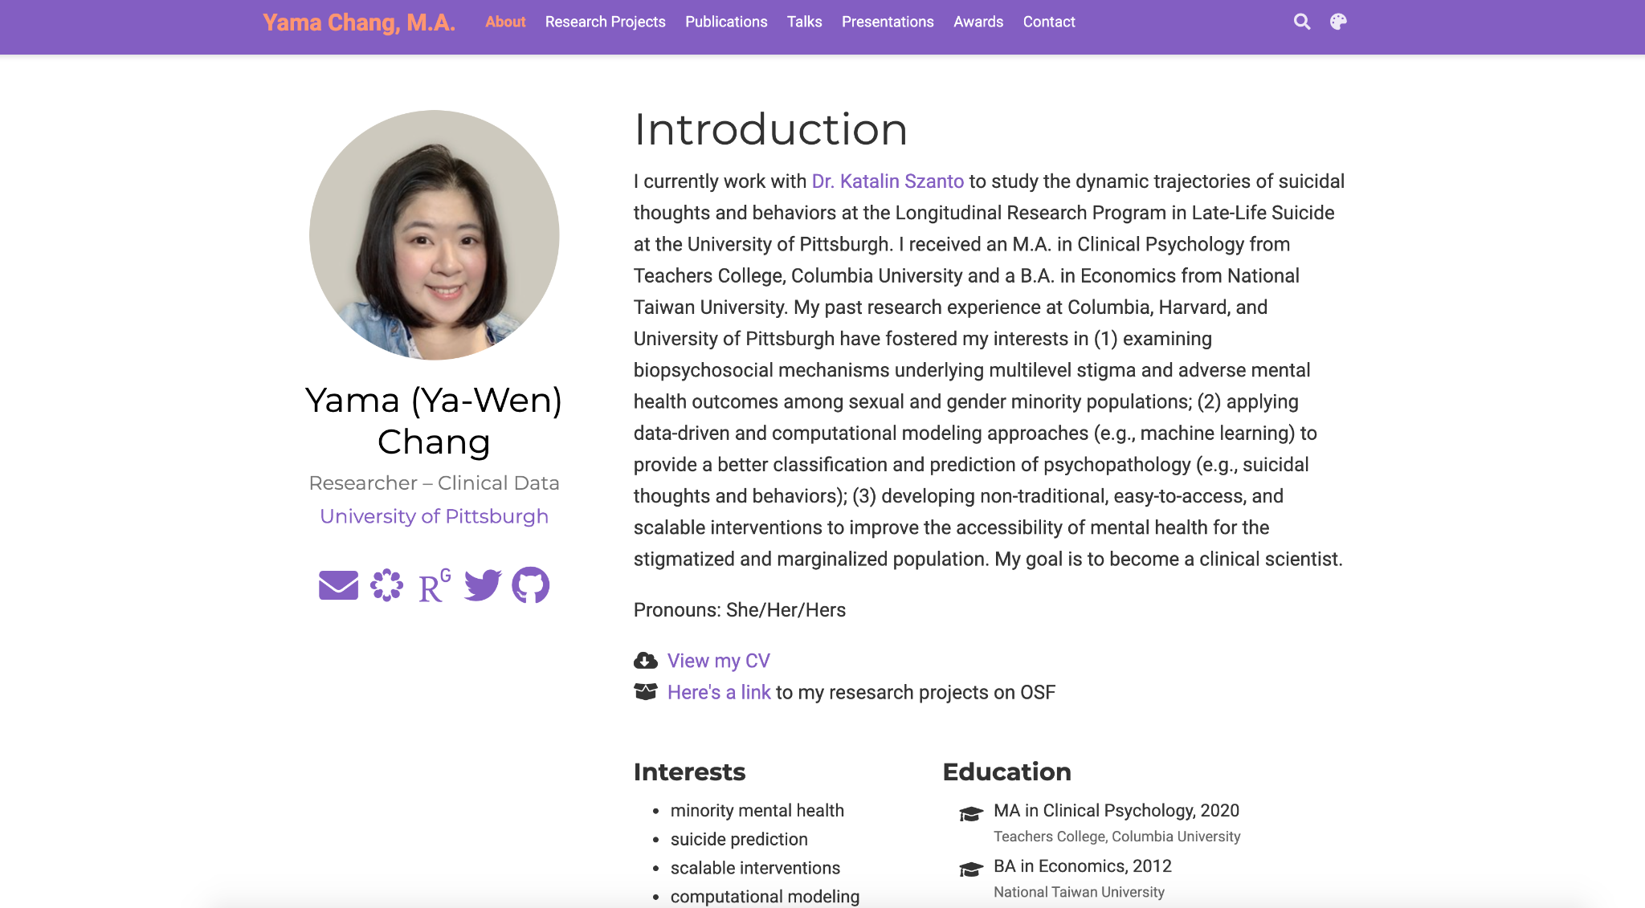
R blogdown

Slide 10
Overview: learning goal
R Studio interface
Establish good habits now (to make your life easier!)
Reproducibility
Get started
Create a new R script
Run codes
Install and load packages
Working Directory
Let’s do some coding!
Computation - operation and objects
Data frames
Data structures

Slide 11
Before we actually start
Installation of R and R Studio
R - programming language: https://www.r-project.org/
R Studio: an integrated development environment (IDE) for R.
https://www.rstudio.com/products/rstudio/download/

Slide 12
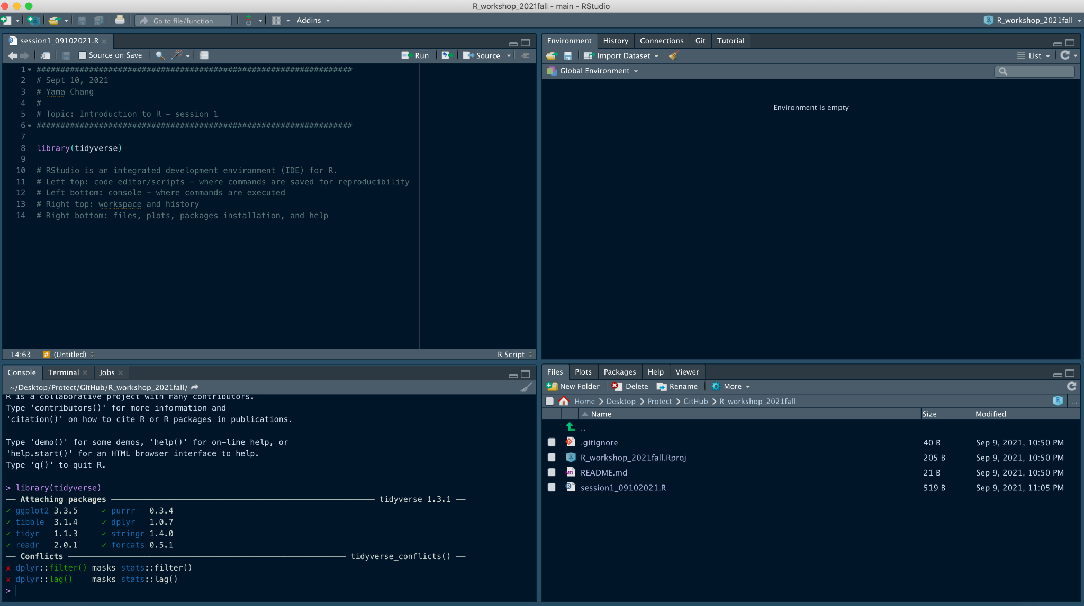
R Studio interface
Environment/history
Code editor/script
Console
Files/output/packages/help

Slide 13
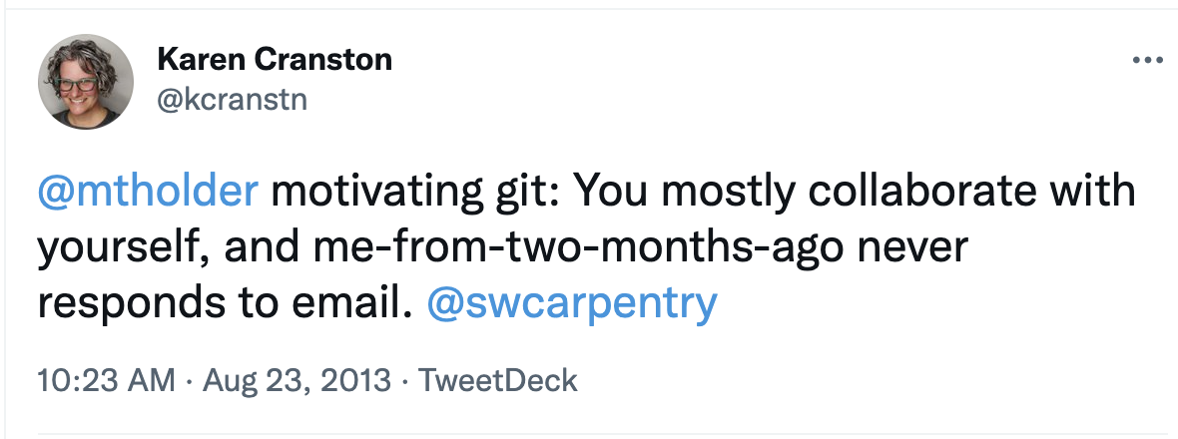
Establish good habits now
Some R basics
Code is case sensitive
No autocorrect (which is good!)
Some good habits
Establish a variable name convention
this_is_snake_case (preferable!)
this.is.period.case
ThIsNoTaNaMiNgCoNvEnTiOn
Comment your codes with # for reproducibility and save your headache
Make readable/beautiful codes

Slide 14
Reproducibility
Give the same code and data, anyone should be able to reproduce each step of your work/analysis and show the same results
One day someone will reproduce your work - be prepared!

Slide 15
Get started
Create a new R script
File → New Files → R Script
Run code: put your cursor at any place of a line of code
Command + enter (Mac)
Ctrl + enter (Windows)
Autocompletion - start typing a variable name and click tab

Slide 16
Get started
Install packages - collections of functions and data sets developed by the R user community
Currently, there’re 18149 available packages!
Only need to install once in your environment
install.packages("tidyverse")
Load packages
Need to load every time in your environment
library(tidyverse)
Working Directory - where you store this project/script/data/plot
getwd()
setwd(“/Users/yama/Box/Yama/R workshop”)
https://cran.r-project.org/web/packages/

Slide 17
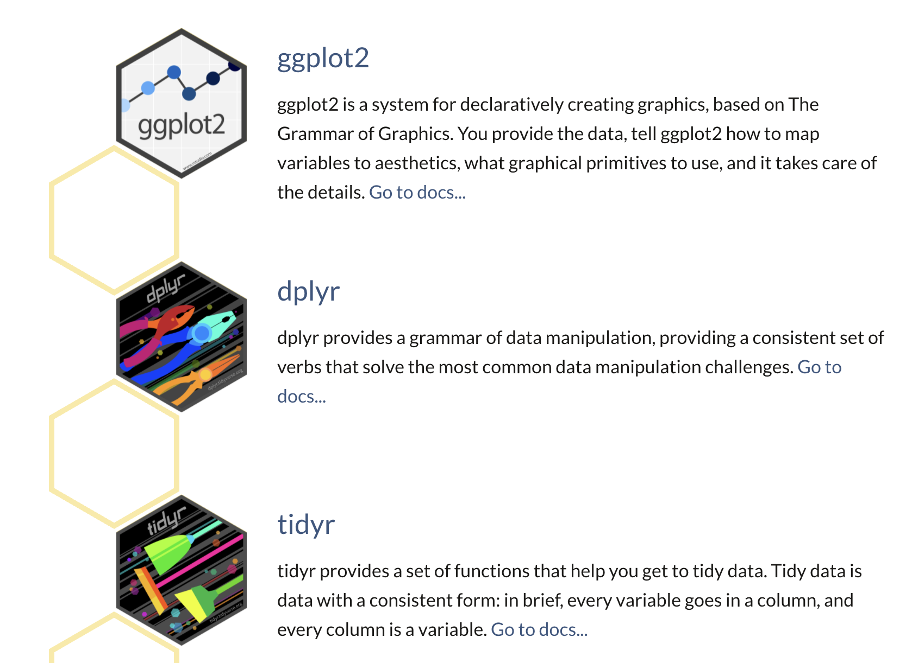
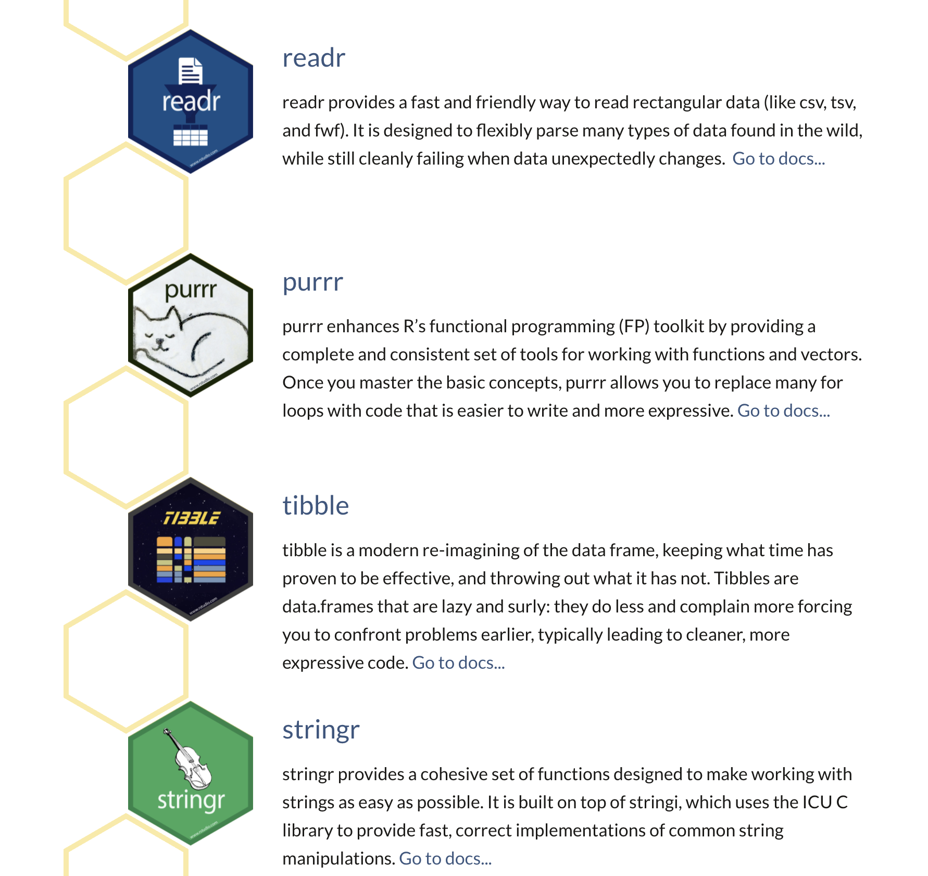
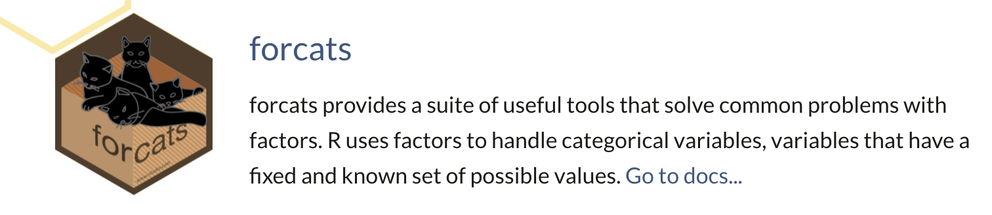
Tidyverse
A package made for easier, faster, and more fun in coding
You can basically use this package for everything in data science - tidy data, analysis, visualization, and analysis.

Slide 18
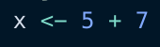
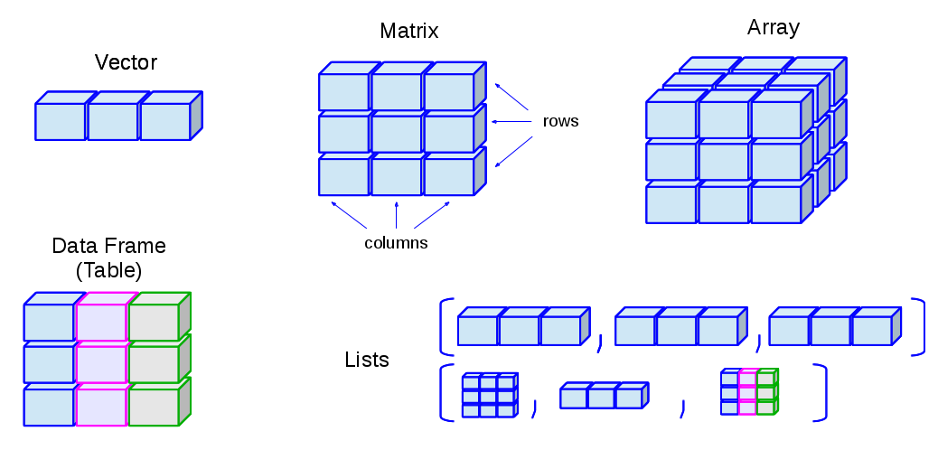
Let’s do some coding!
Computation: operation and objects
Data Structure
Object
Value
http://venus.ifca.unican.es/Rintro/dataStruct.html

Slide 19
Some mindset of coding
😸
Read the errors
A lot of googling!
You can basically find all solution at stackoverflow
Plan for mistakes
It’s TOTALLY fine to make mistakes
Write codes that make it easy to fix - clean codes
Learning curves
🤩
👶
😒
😭

Slide 20
Helpful resources
R Studio cheatsheet
A (very) short intro to R
R for Data Science
Data Science I (P8105) at Columbia University School of Public Health

Slide 21
Thank you!
You can find my slides and codes at my GitHub
Also find me at: changy11@upmc.edu

